Slide 1
STUDY OF STRUCTURAL, MICROSTRUCTURAL AND MECHANICAL PROPERTIES OF BOROSILICATE-BASED GLASS-CERAMIC COMPOSITES
M. SUJITH CHANDRA 19071A0333
P. SIDDARDTH 19071A0339
P.V.S. SURAJ 19071A0341
V. SIMON PRASHANTH 19071A0358
Under the guidance of,
Dr.CH. PRIYADARSINI
Mechanical Engineering

Slide 2
Abstract
This report examines the benefits of using Borosilicate-Alumina and Borosilicate-Copper Oxide composites in place of Borosilicate Glass. Pellets were created by compacting and sintering the materials, and their mechanical properties were tested with varying percentages of Alumina and Copper Oxide. Optical microscope analysis revealed that the composite material had increased stiffness, while SEM analysis showed the formation of chip-like structures with Alumina and nanoparticles with Copper Oxide. The composite pellets showed a substantial increase in hardness, particularly with 10% Alumina and a combination of 10% Alumina and 10% Copper Oxide. The use of these composites could provide an economical solution to the breakage and contamination issues associated with Borosilicate Glass.

Slide 3
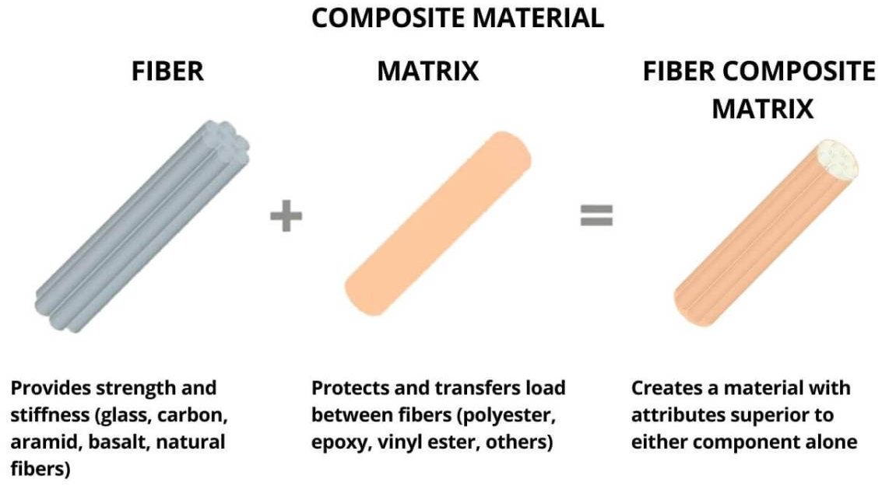
Introduction to Composite Materials
Composite materials are a type of engineered material created by combining two or more distinct components with differing qualities to create a new material with improved properties. In order to create a composite material with better mechanical, thermal, electrical, and other qualities, the component elements, also known as constituent materials, are merged while maintaining their distinct features.
In a number of industries, including aerospace, automotive, construction, sports equipment, and biomedical engineering, composite materials have been thoroughly explored and produced.

Slide 4
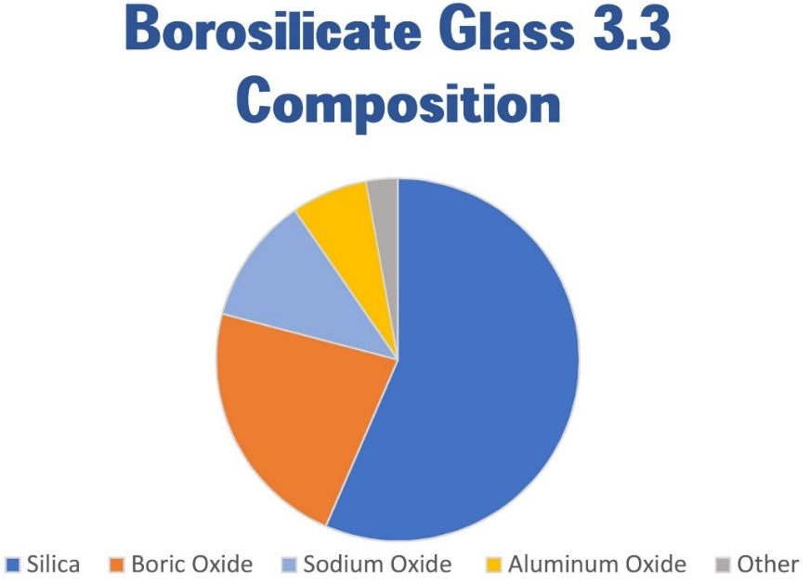
Introduction to Composite Materials
Composite materials are widely used because of the special combination of qualities that make them the perfect solution for many technical issues. For instance, composite materials may be made to be both strong and light, which makes them perfect for use in aerospace applications.
Borosilicate glass is a form of glass that is mostly made
of boron trioxide and silica. The exceptional resilience
of this kind of glass to mechanical impact, chemical
corrosion, and thermal stress is well recognized.
Borosilicate glass is frequently used for home items
like cookware and drinkware as well as in scientific and
laboratory settings.

Slide 5
Literature Review
Dakuri Ramakanth et al. [1] This research reviews unique hybrid packaging materials, cyclic olefins polymers with nanolayer glass, and vaccine vials for the distribution and storage of COVID-19 vaccines. With an emphasis on bar codes, rapid response codes, vaccine vial monitors, anti counterfeiting, and traceability measures, they concentrated on vaccine packaging, auto-disable syringes, stoppers, and closures, as well as a chronology of the packaging system and the labeling of the vaccine packages.
A. Wereszczak et al. [2] This paper examines the strength and contact damage responses of soda-lime-silicate and borosilicate glass. This essay provides information on the mechanical, chemical, and other characteristics of borosilicate and soda-lime glass that are being studied.
Sebastian Bruns et al. [3] The addition of Al2O3 caused structural changes in the borosilicate glass, including the formation of new bonds and changes in the coordination of the network-forming cations. The mechanical characteristics of the glass were enhanced as a result of these modifications, including an increase in hardness, fracture toughness, and compressive strength.The research also revealed that between 5-7 mol% of Al2O3 was the ideal amount to add to borosilicate glass, as higher amounts decreased the glass transition temperature and reduced the mechanical properties.

Slide 6
Literature Review
Poussy Aly et al. [4] In this study, alternative transparent amorphous borosilicate glass systems incorporating metal oxides comprising PbO, BaO, and SrO at different concentrations were tested as gamma-ray shielding materials. Analysis of the results obtained for the prepared samples was compared in terms of the half-value layer and density for some glass matrices used in the industry comprising RD-30 and LX-57B, where the aim was to determine the effectiveness of the glass matrices at protecting against gamma radiations discussed.
Aldo R. Boccaccini et al. [5] Calcination and addition of Alumina rich residue improved the properties compared to pure BSG glass with the best balance between strength, density, and crystalline volume. Though the formation of cristobalite was not possible with sintering, the valoxy evolved gases that were entrapped and formed closed pores, and with the increase in temperature, the pores grew in size, leading to a reduction in strength.
G. Banu Prakash et al. [6] The gain in fracture toughness at room temperature is considerably smaller than the value expected from the dispersion of metallic particles in a brittle matrix. Microcracking at the interfaces appears to be responsible for the poor toughness. The apparent viscosity of composites at a given temperature was not influenced by the dispersed phase content. Trends in the variations of flow stress and viscosity of composites can be attributed to the soft and ductile nature of dispersed Cu in the glass matrix.

Slide 7
Objectives
Study and Selection of Reinforcement Material for Borosilicate.
2. Fabrication of composite pellets of various compositions consisting of the selected materials with Borosilicate.
Testing of the composites prepared for Structure, Microstructure, and Mechanical properties by appropriate testing methods.

Slide 8
Work Methodology
Select the matrix material
Literature research on Reinforcement material
Select the reinforcement material
Determine the volume fraction
Prepare the Composite Material
Mixing the Materials through Grinding
Manufacturing pellets with Hydraulic press
Sintering the Pellets in a Muffle Furnace
Testing the Pellet composites

Slide 9
Process Flow for Selection of Materials
  Define application and performance requirements
Step1
  Identify potential materials that can meet requirements
Step 2
  Evaluate properties of potential materials
Step 3
  Compare the properties of potential materials
Step 4
  Select Which can meet the requirements
Step 5
  Start Preparation of Composite Material
Step 6

Slide 10
Properties of Available Reinforcements
Material | Strength (MPa) | Elastic Modulus (GPa) | Fracture Toughness (MPa/m^(1/2)) | Thermal Conductivity (W/mK) | Thermal Expansion Coefficient (10^-6/K)
Alumina | 350-500 | 350-450 | 3-4 | 20-35 | 7-8
Zirconia | 800-900 | 200-210 | 4-5 | 2-4 | 10-11
CNTs | 20-100 | 1.0-1.2 | 2-3 | 3000-6000 | 1-2
SiC | 400-600 | 400-500 | 3-4 | 120-150 | 3-4
TiO2 | 150-250 | 200-240 | 2-3 | 5-10 | 8-9
CuO | 70-100 | 130-180 | 0.7-1.1 | 10-15 | 8.9-9.6

Slide 11
Selection of Materials
Alumina
Alumina is a preferred reinforcement material for borosilicate composites due to its high hardness and wear resistance. The improved mechanical characteristics of the resulting composite material, which is made of borosilicate and alumina, include higher hardness, strength, and stiffness.
Copper Oxide
Addition of Copper Oxide has the possibility of increasing the thermal properties of a material as it can withstand high temperatures, and mechanical properties such as hardness, strength and toughness which increases the overall durability of the material. Copper oxide is also a comparatively less expensive material and can be a viable option for the use as a reinforcement material for Borosilicate.

Slide 12
PREPARATION OF COMPOSITE
Preparation process:
Preparation of composite material is basically the making of a new material consisting of 2 or more materials. There are various methods for composite preparation depending on the type of material being prepared and in this case, since the materials are in powdered form, we follow the Powder metallurgy method for preparation of the material. For composite preparation, the steps usually are as follows:
Scaling and mixing
Grinding
Pellet Preparation
Sintering
Polishing

Slide 13
PREPARATION OF COMPOSITE
SCALING
The material is scaled upon the DT830D (0.01g to 200g) Gold Weighing Scale. The 3 grams are used for each composition sample.
MIXING
Once, the scaling process is done for the different weight ratios of the parent materials, the materials are poured in to a mortar and mixed with a pestle by hand. The mixing is done by hand for a time duration of 30 minutes.
GRINDING :
In the grinding process, each dried sample is divided into 3 different samples, i.e. 1gm each for pellet preparation. These 1gm samples are taken separately into the motar and one drop of PVA solution is added to the mixture and grinded for about 2 minutes for proper binding of each 1gm sample.

Slide 14
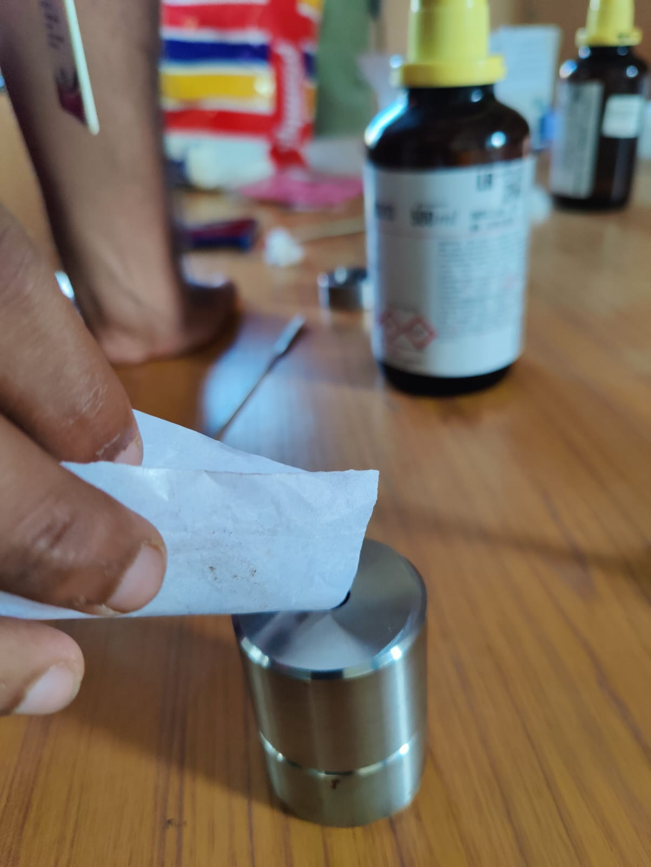
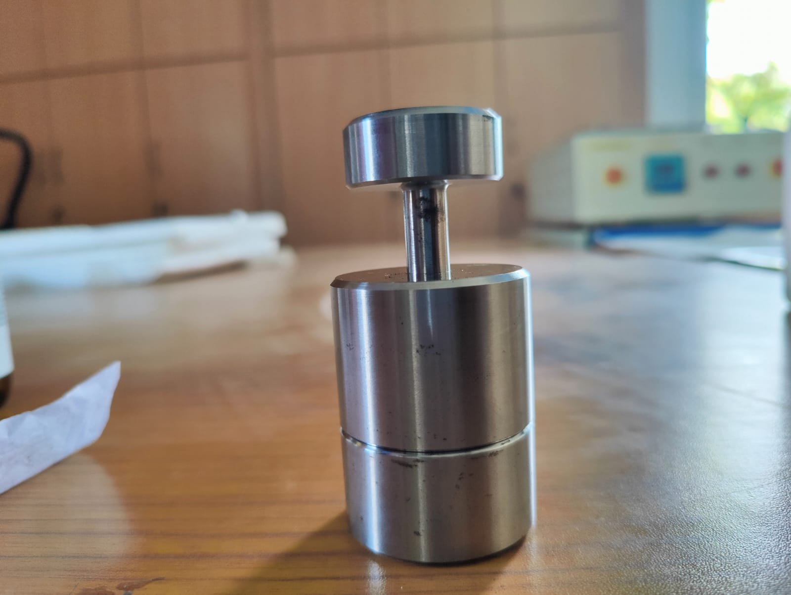
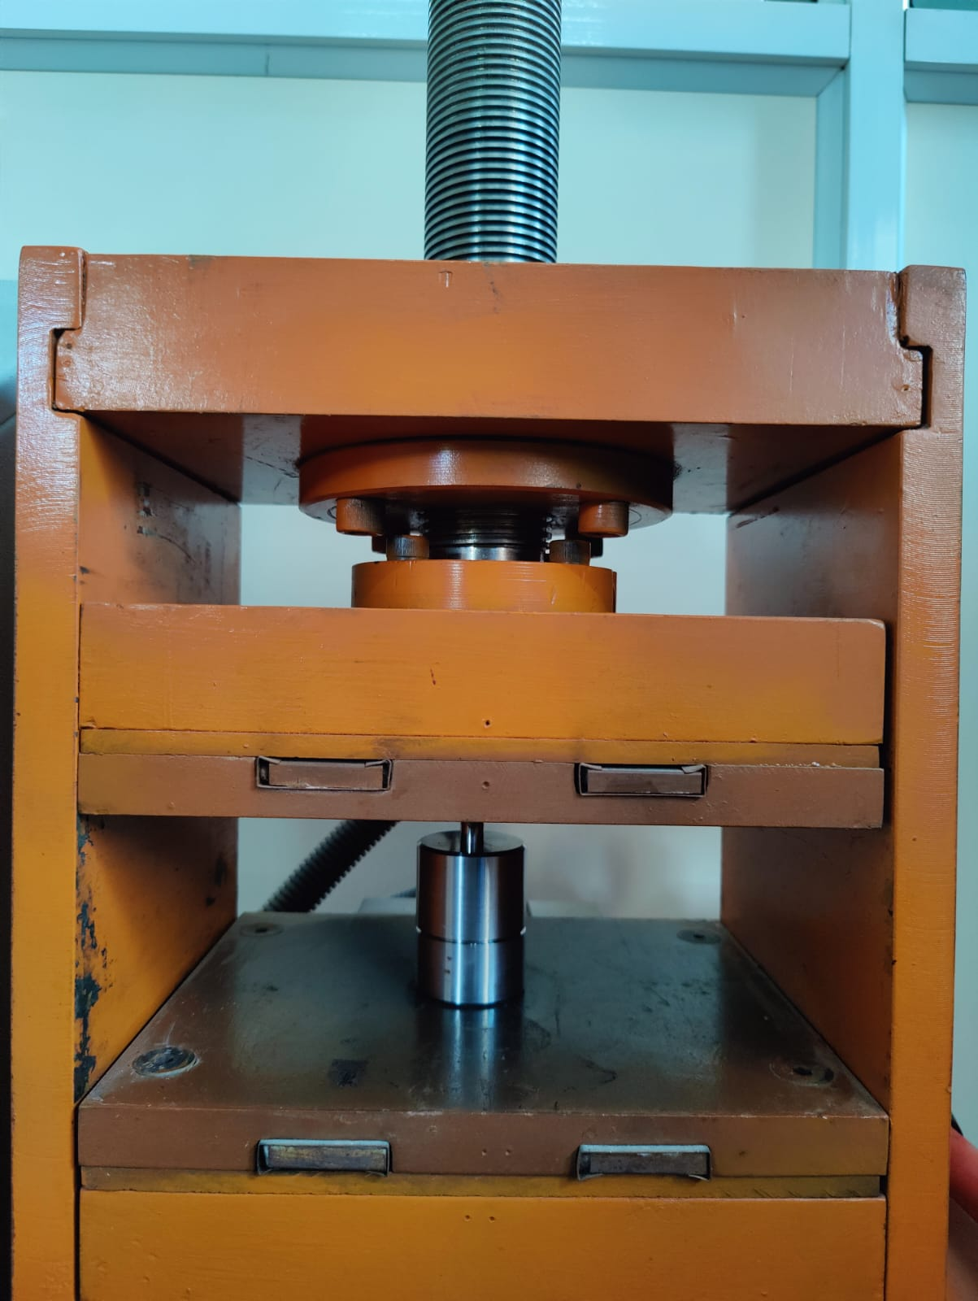
PREPARATION OF COMPOSITE
Pellet Preparation:
IR FTIR XRF dies Set is used for the preparation of pellets. Die set is variable by the pellet size and volume, for this composite 10mm Die set is utilized. This device is used to compact the powder to the defined diameter. The pellet adjusts the height by the amount of powder added to the die set.

Slide 15
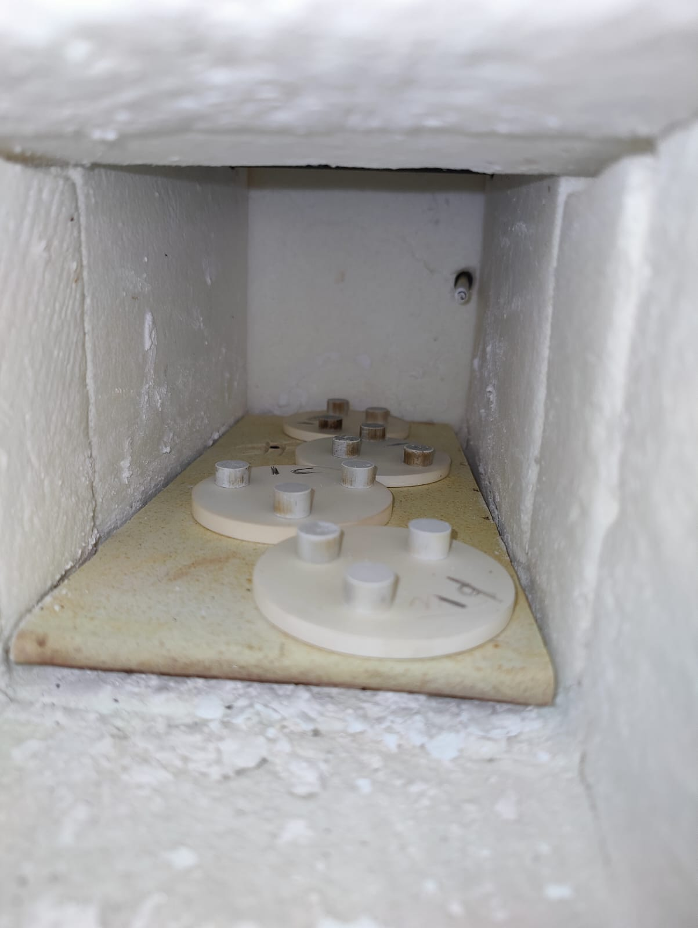
PREPARATION OF COMPOSITE
Sintering:
After preparing the pellets in the compaction device, the pellets are heated at a high temperature that is below the melting point of all components of the composite material. First pellets are sintered at 300°c for 20 minutes and gradually increasing temperature to 5°c per minute until reaching 850. Then pellets are sintered in an oven at 850°c for 30 minutes and gradually slowed like they increase and cooled down completely in the oven overnight.

Slide 16
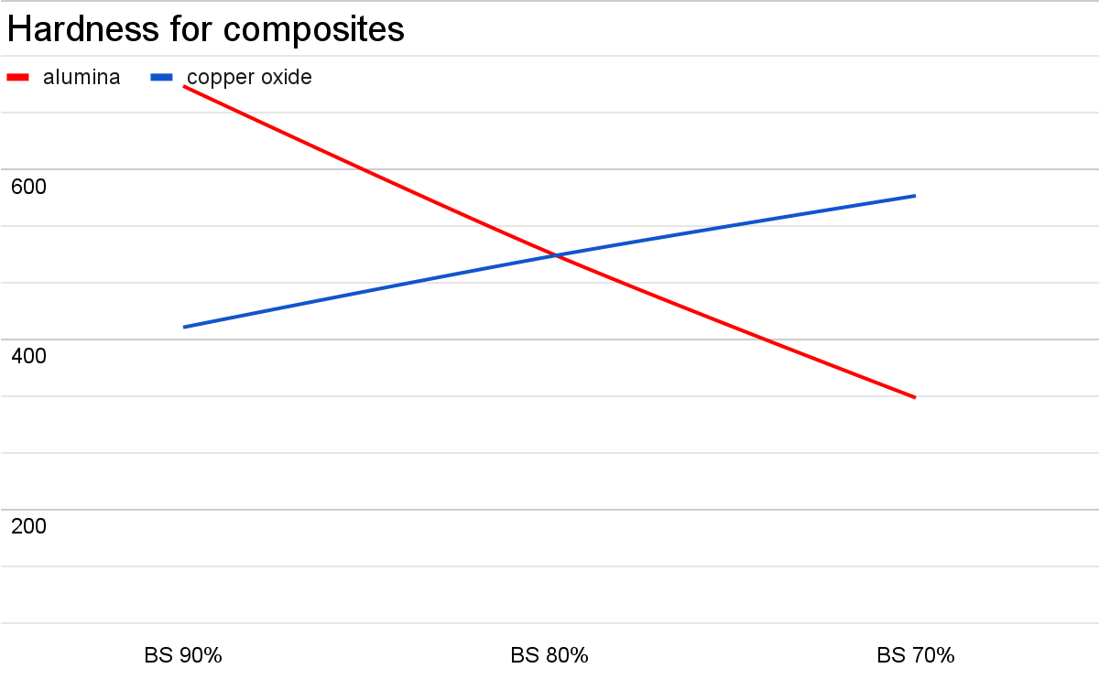
RESULTS AND DISCUSSIONS
RESULTS AND DISCUSSIONS
For the composite prepared, in this scenario, the tests performed are Micro Vickers Hardness, Optical Microscope at 200x, and Scanning Electron Microscopy. These tests performed on the composite material provided the following results that justify the project.
Micro Vickers Hardness:
Micro Vickers Hardness is an alternate hardness testing method developed to test the hardness of materials. This is an easier method than other hardness tests as the calculations do not depend on the indenter as the indenter can be used for all materials irrespective of hardness.The best hardness sample we got from the tests are the borosilicate 90 wt % and alumina 10 wt% which is 150 HV more than the base.

Slide 17
RESULTS AND DISCUSSIONS
Sample ID | Hardness Value(HV0.3) | Avg. Hardness Value (HV)
BS 100% | (548, 554, 544) HV0.6 | 548.66
BS 90% + Al₂O₃ 10% | (691, 705, 700) HV0.3 | 698.66
BS 80% + Al₂O₃ 20% | (537, 459, 511) HV0.7 | 502.33
BS 70% + Al₂O₃ 30% | (346, 313, 335) HV0.8 | 331.33
BS 90% + CuO 10% | (389, 418, 436) HV0.4 | 414.33
BS 80% + CuO 20% | (518, 477, 498) HV0.10 | 497.66
BS 70% + CuO 30% | (556, 589, 563) HV0.9 | 569.33
BS 80% + Al₂O₃ 10% + CuO 10% | (580, 619, 588) HV0.5 | 595.66

Slide 18
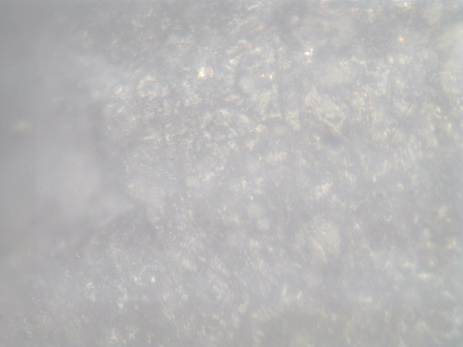

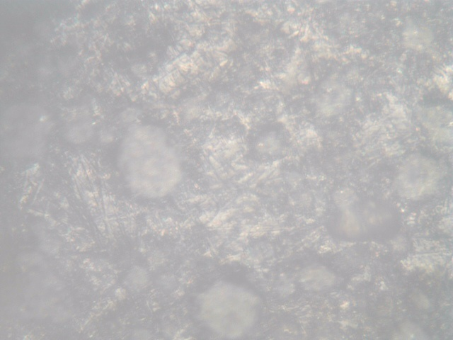
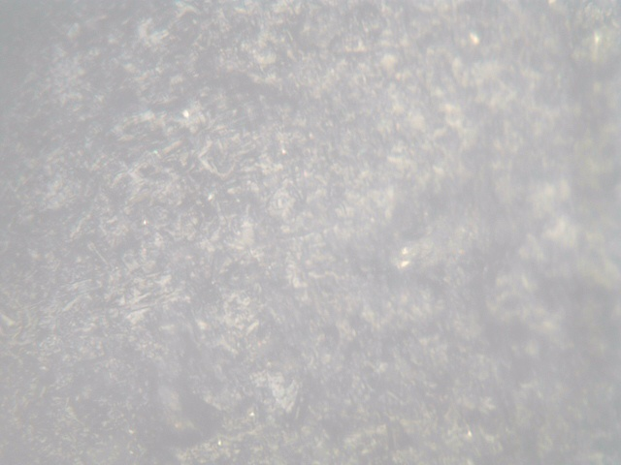
RESULTS AND DISCUSSIONS
Structural Analysis Through Optical Microscope:
The above images depict the Structure of the composite materials at 200x magnification done by using an Optical Microscope. This observation helps in the classification of the composites and also helps determine the surface structure of the composite material. By observing through the optical microscope, we can determine various surface features of the material and also check for defects on the surface.
Borosilicate(100%) BS(80%) + Al (20%) BS(80%) + Cu2o(20%) BS(80%)+Al(10%)+Cu2o(10%)

Slide 19
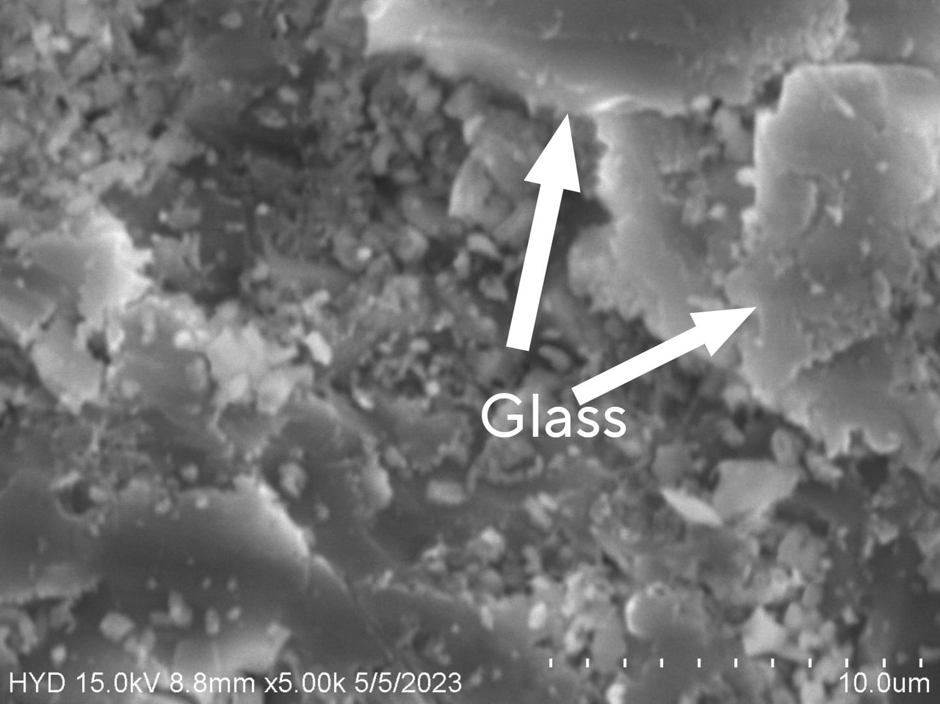
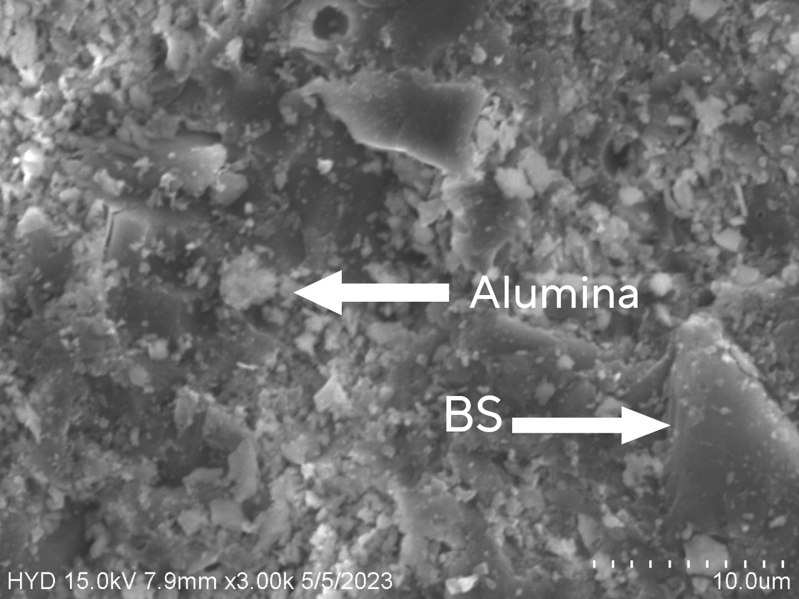
RESULTS AND DISCUSSIONS
SEM ANALYSIS :

Slide 20
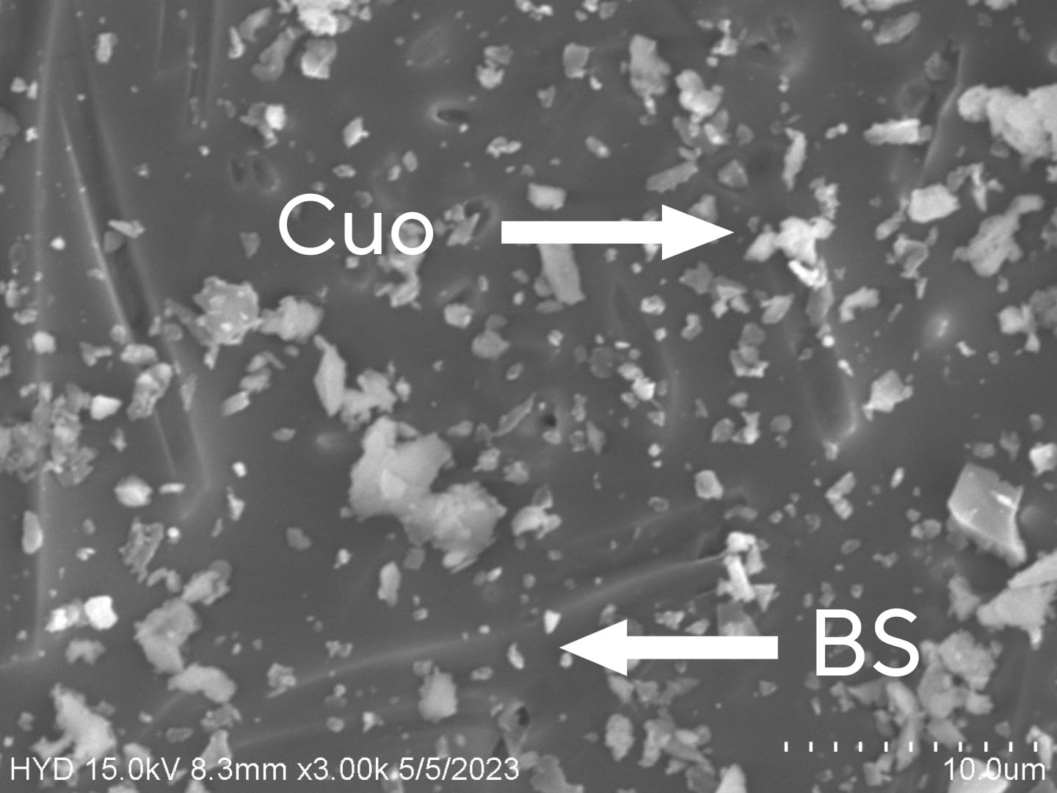
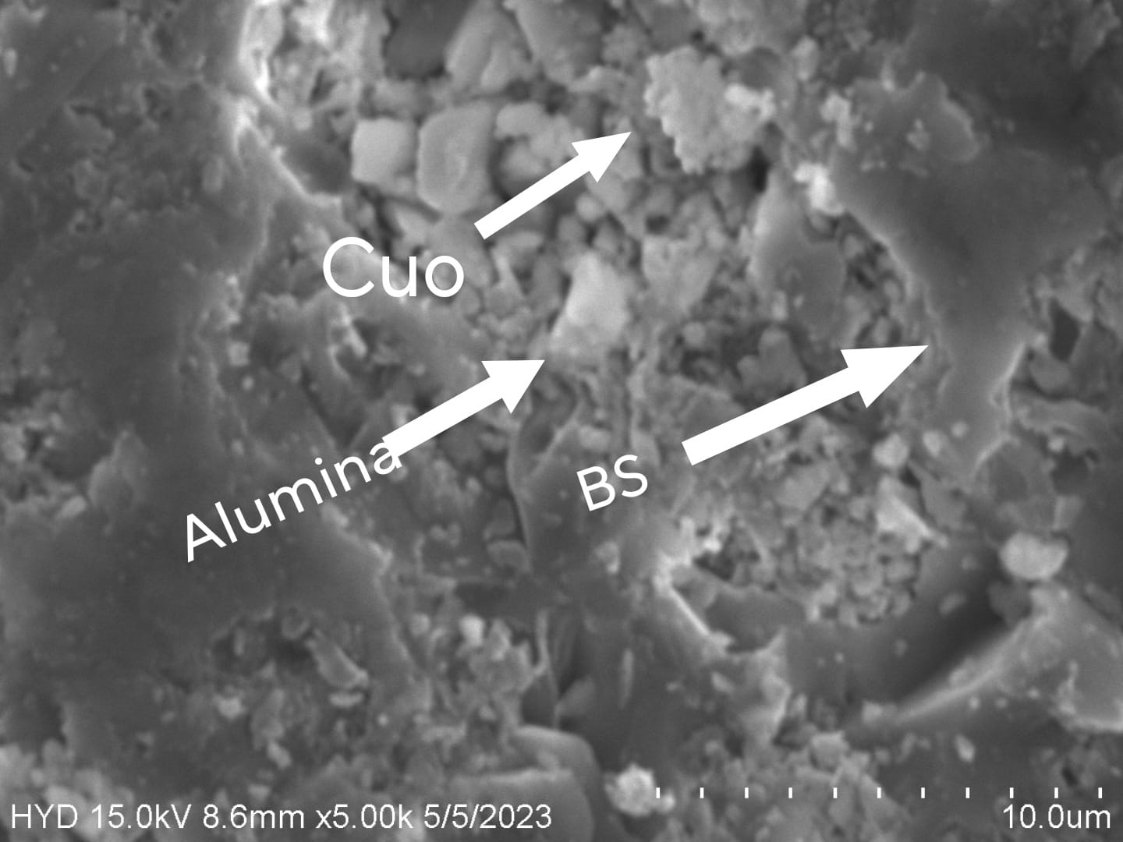
RESULTS AND DISCUSSIONS
From the SEM analysis, there is a clear formation of various structures of the materials used, like the smooth patches formed by glass, chip-like structures by the Alumina, and spheres formed by Copper Oxide. The sintering process delivered the required results and the structures are clearly visible from these images.

Slide 21
CONCLUSIONS
CONCLUSIONS:
In summary, the addition of Alumina (Al2O3) and Copper Oxide (CuO) to the Borosilicate composite has improved the structure, microstructure, and mechanical hardness. The highest hardness values were obtained with 10% Alumina (Al2O3) and 90% Borosilicate, and the next highest with a composite of all three materials. Adding Alumina (Al2O3) initially increases hardness, but further addition reduces it, while adding Copper Oxide (CuO) increases hardness with increasing wt%. Overall, the composite materials showed improved properties compared to the original 100% Borosilicate composition.
FUTURE SCOPE:
The research done till this point through this project proves that a slight addition of Alumina and Copper Oxide to the borosilicate composite can improve its properties by a substantial value and shows a better microstructure of the pellets. While this project has achieved its main objective of improving the said properties of Borosilicate, there are several areas where the project can be extended and improved. New materials and more cost-efficient materials may be used for the composite preparation. More compositions and more precise compositions can be tried for the same materials. The sintering process can be replaced by the glass preparation process to achieve a better

Slide 22
References
[1] D. Ramakanth, S. Singh, P. K. Maji, Y. S. Lee, and K. K. Gaikwad, “Advanced packaging for distribution and storage of COVID-19 vaccines: a review,” Environ. Chem. Lett., vol. 19, no. 5, pp. 3597–3608, 2021, doi: 10.1007/s10311-021-01256-1.
[2] A. Wereszczak, K. Johanns, C. J. Anderson, T. Behner, and P. Patel, “Strength and contact damage responses in a soda-lime-silicate and a borosilicate glass,” no. OCTOBER 2006, 2006, [Online]. Available:
[3] S. Bruns et al., “Influence of Al2O3 Addition on Structure and Mechanical Properties of Borosilicate Glasses,” Front. Mater., vol. 7, p. 189, Jul. 2020, doi: 10.3389/FMATS.2020.00189/BIBTEX.
[4] P. Aly, A. A. El-Kheshen, H. Abou-Gabal, and S. Agamy, “Structural investigation and measurement of the shielding effect of borosilicate glass containing PbO, SrO, and BaO against gamma irradiation,” J. Phys. Chem. Solids, vol. 145, no. April, p. 109521, 2020, doi: 10.1016/j.jpcs.2020.109521.
[5]R. K. Chinnam, A. R. Boccaccini, E. Bernardo, and H. Epstein, “Glass-ceramic composites from borosilicate glass and alumina-rich residues,” Int. J. Appl. Ceram. Technol., vol. 12, no. S2, pp. E19–E27, 2015, doi: 10.1111/ijac.12197.
[6]G. Banu prakash, V. Katyal, V. S. R. Murthy, and G. S. Murty, “Mechanical behaviour of borosilicate glass-copper composites,” Compos. Part A Appl. Sci. Manuf., vol. 28, no. 9–10, pp. 861–867, 1997, doi: 10.1016/S1359-835X(97)00052-3.

Slide 23


